Slide 1
Proof of Concept
Lecturer: Ngo Huy Bien
Software Engineering Department
Faculty of Information Technology
VNUHCM - University of Science
Ho Chi Minh City, Vietnam
nhbien@fit.hcmus.edu.vn

Slide 2

Objectives
To create a proof of concept.

Slide 3

Contents
Proof of Concept
Questions and Answers (Text)
Algorithm (Code)
Domain Model (Code)
Database Model (Code)
Architecture (Solution Sketch Code)
Testbed (Code)
Small Exercises (Code)
Pilot (Trial) (System)

Slide 4

References
Karl Wiegers and Joy Beatty (2013). Software Requirements. Microsoft Press.

Slide 5

Can You Really Do Something?

Slide 6

Previous Similar Projects

Slide 7

A Difficult Feature Implementation

Slide 8


Slide 9


Proof of Concept
A proof of concept or a proof of principle is realization of a certain method or idea(s) to demonstrate its feasibility, or a demonstration in principle, whose purpose is to verify that some concept or theory has the potential of being used.
The purpose is to verify that some concept or theory is probably capable of being useful.

Slide 10
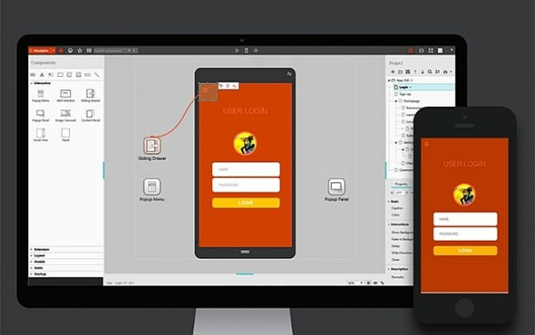
Vertical Prototype [1]
A proof of concept, also known as a vertical prototype, implements a slice of application functionality from the user interface through all the technical services layers.
A proof-of-concept prototype works like the real system is supposed to work because it touches on all levels of the system implementation.
To make the results meaningful, such prototypes are constructed by using production tools in a production-like operating environment.

Slide 11

When?
Develop a proof of concept
when you’re uncertain whether a proposed architectural approach is feasible and sound, or
when you want to optimize algorithms, evaluate a proposed database schema, confirm the soundness of a cloud solution, or test critical timing requirements.

Slide 12

How to Create a Proof of Concept?
Concrete difficult problem
Input – Output
Solution (Theory/Design)
Intuition
Formulas
Transformation steps
Implementation (Practice)
Libraries
Concrete results

Slide 13
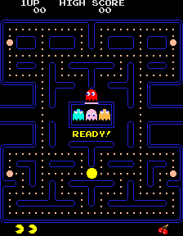
Questions and Answers (Text)
How to display a background?
How to display the Pacman?
How to make the Pacman respond to user inputs?
How to make the Pacman constrained to within the walls?
How to display a ghost?
How to make the ghost move automatically?
How to detect some collision?
How to display some dots?
How to make the Pacman eat dots?
How to find out that the level is complete?

Slide 14
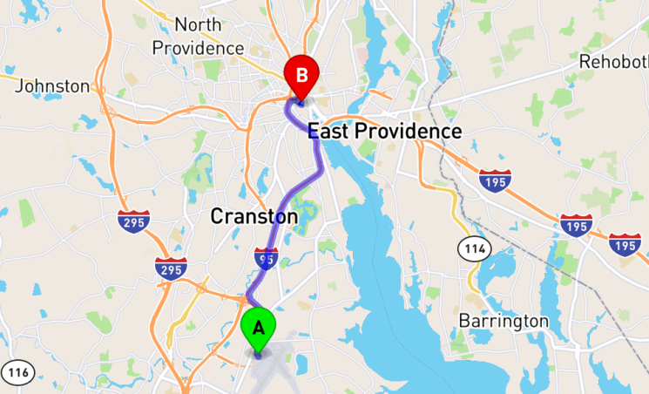
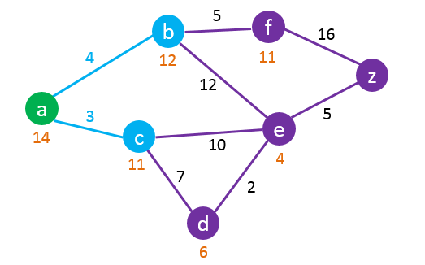
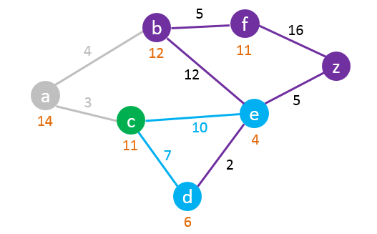
Algorithm (Code)
“What is the shortest route from A to B?”

Slide 15
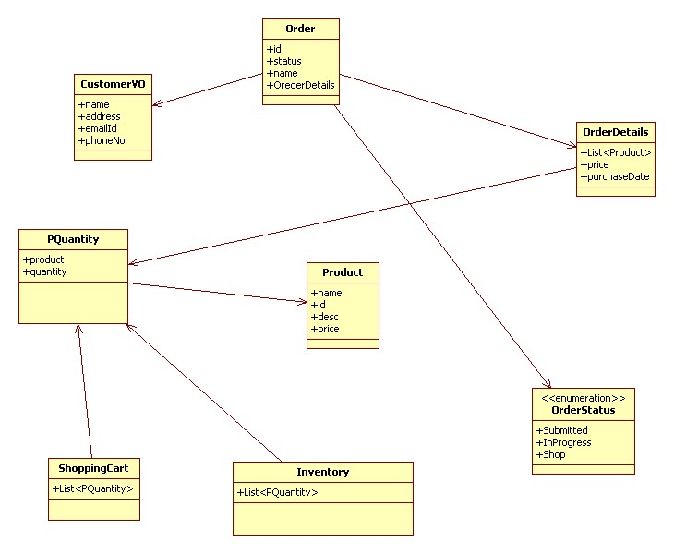
Domain Model (Code)

Slide 16
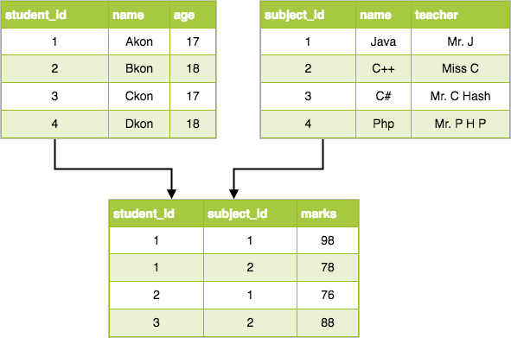
Database Model (Code)

Slide 17
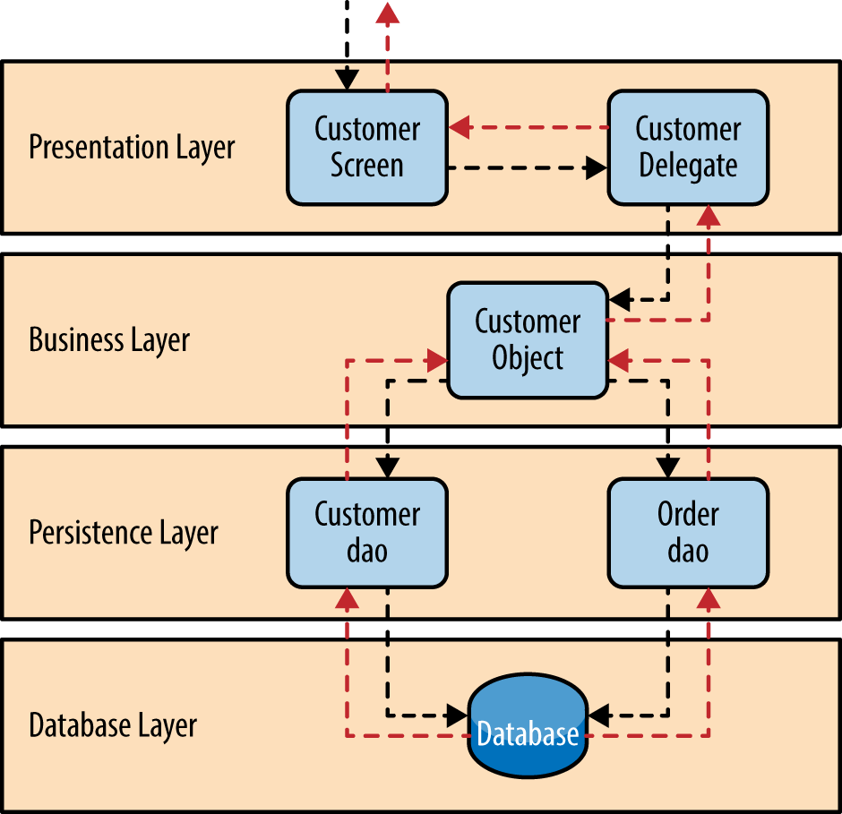
Architecture (Solution Sketch Code)

Slide 18
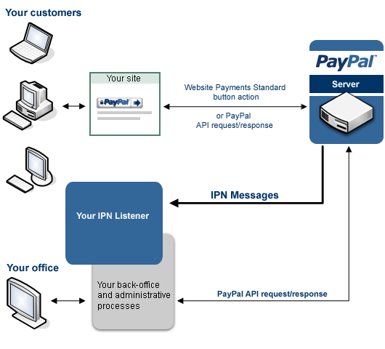
Testbed (Code)
An external component is tested apart from the program/system it will later be added to.
A skeleton framework is implemented around the module so that the module behaves as if already part of the larger program.
Implement a PAY button
What are inputs and outputs?

Slide 19
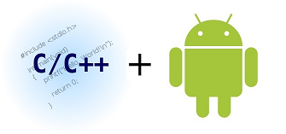
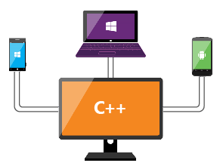
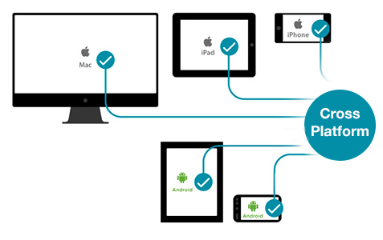
Small Exercises (Code)
Testing a new library, platform or technology.
Just simple (but useful) applications:
Use C/C++ (OpenCV) with Java code (Android) to speed up loading and saving an image.
Write a login feature with Xamarin.
Write a login feature with React Native.

Slide 20


Pilot (Trial) (System)
A pilot (or trial) uses the full production system and tests it against a subset of the general intended audience.
The reason for doing a pilot is to get a better understanding of how the product will be used in the field and to refine the product.
This clearly defines how the system must operate within its environment.
Example: Migrating data from SQL 2005 to SQL 2016.

Slide 21

Why Proof of Concept?
Helps in testing partial solution.
Helps in analyzing requirements completely.
Helps in identifying and planning for risks.
Helps in making cost-benefit analysis.
Helps in making plan for training developers for implementing the system.
Can be reused for actual system.

Slide 22

Too Much Effort Issue
Assigning proof of concept creation task to experts (senior developers, technical architects).
Leveraging fragments of existing or open source codebase.
Leveraging frameworks, components, libraries, cloud services.

Slide 23

Thank You & See You Again

